Slide 1

Reaching Great Heights: A Pathway to Reduced Maternal Mortality
“Dèyè mòn gen mòn emerges.” “Beyond mountains there are mountains.”
Karlie J, Kate B, Tasnia N, Matt S

Slide 2

Table of contents
01
02
03
Understanding the Problem
Problem Tree
Proposed Solution
Theory of Change
SWOT Analysis
Monitoring & Evaluation
Realist Evaluation

Slide 3
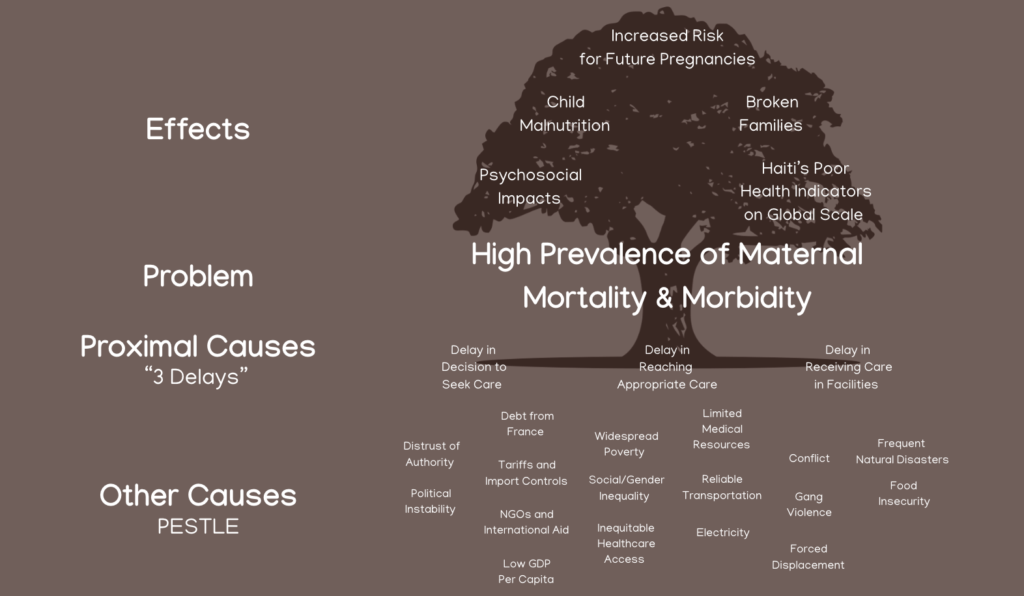
Problem Tree

Slide 4
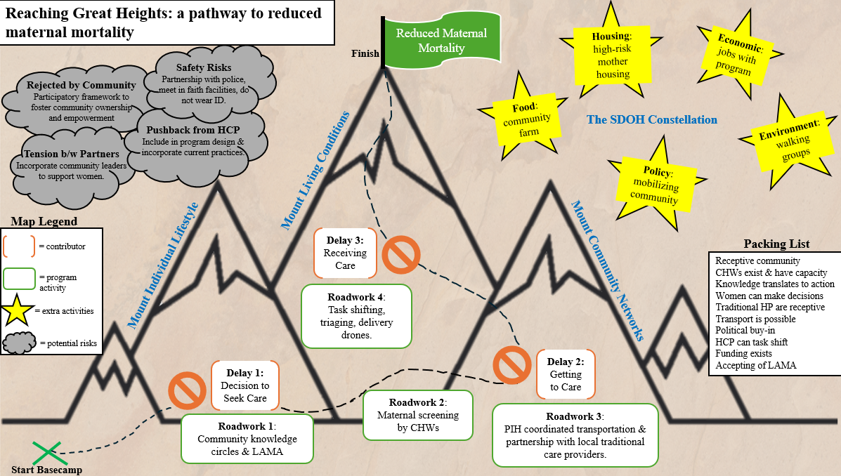
Notes:
Deeper analysis of decision to seek care
Antenatal care checks for everyone
CHW to take blood pressure and blood glucose is good
Nurses and healthcare workers going out to communities, group antenatal checks
How can we strengthen health system and when it fails, what backups do we have?
Expert attendant
Means of transporting to hospital

Slide 5
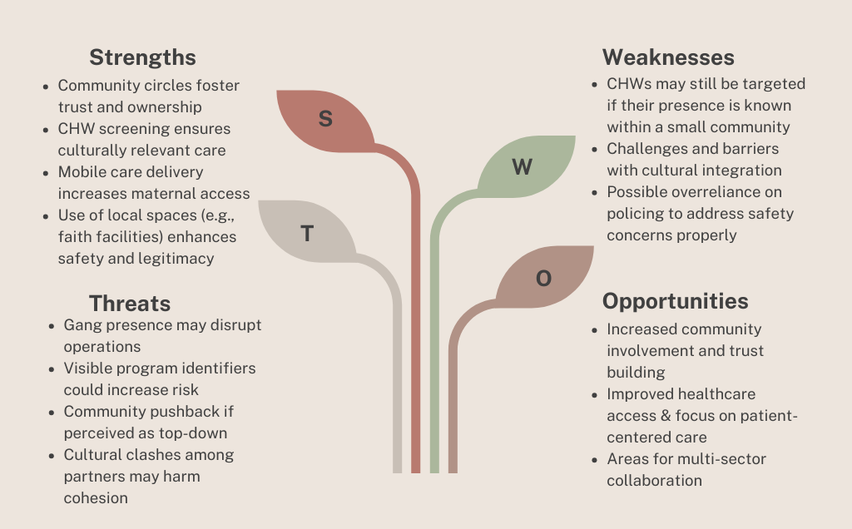
Risk and Mitigation Strategy SWOT Analysis

Slide 6
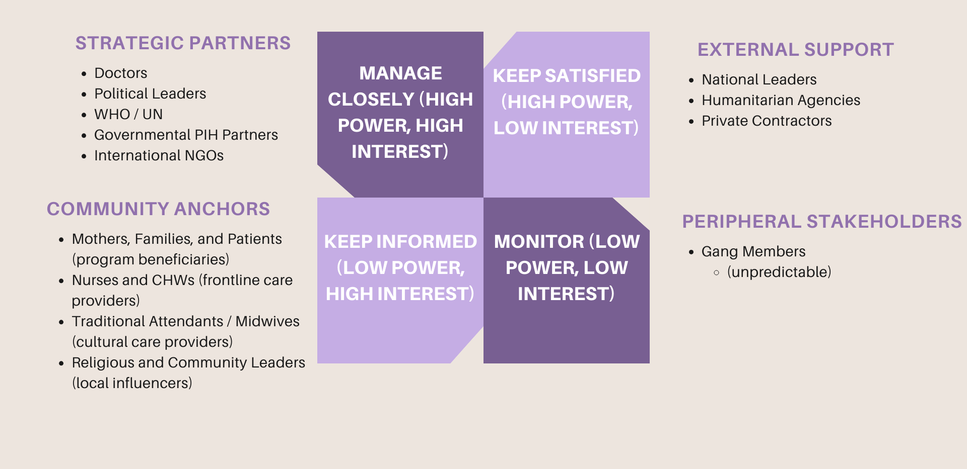
Stakeholder Analysis

Slide 7
Monitoring & Evaluation
Outcome | Indicator | Data Collection | Timeline
Improved knowledge on maternal health (delay 1) | Group attendance Knowledge survey scores Decision-making process | Attendance sheets Pre/post group surveys Qual interviews w/ mothers | Short-term, within first year
Transport & referral to care facilities (delay 2) | Average time to care facility Amount of care referrals Referral process | PIH members track travel time CHW track referrals Qual interviews w/ CHWs | Short-term, within five years
Improved home birth outcomes (delay 2) | Traditional HP attendance at births Average time for care to arrive Mother’s experience | PIH members track attendance & average time Qual interviews w/ mothers | Short-term, within 5 years
Timely care received (delay 3) | Hospital wait times HCP experience Mothers experience | PIH members track hospital wait times Qual interviews w/ HCP Qual interviews w/ mothers | Medium-term, monitor at 5, 10, and 15 years

Slide 8

Reduced Maternal Mortality

Slide 9
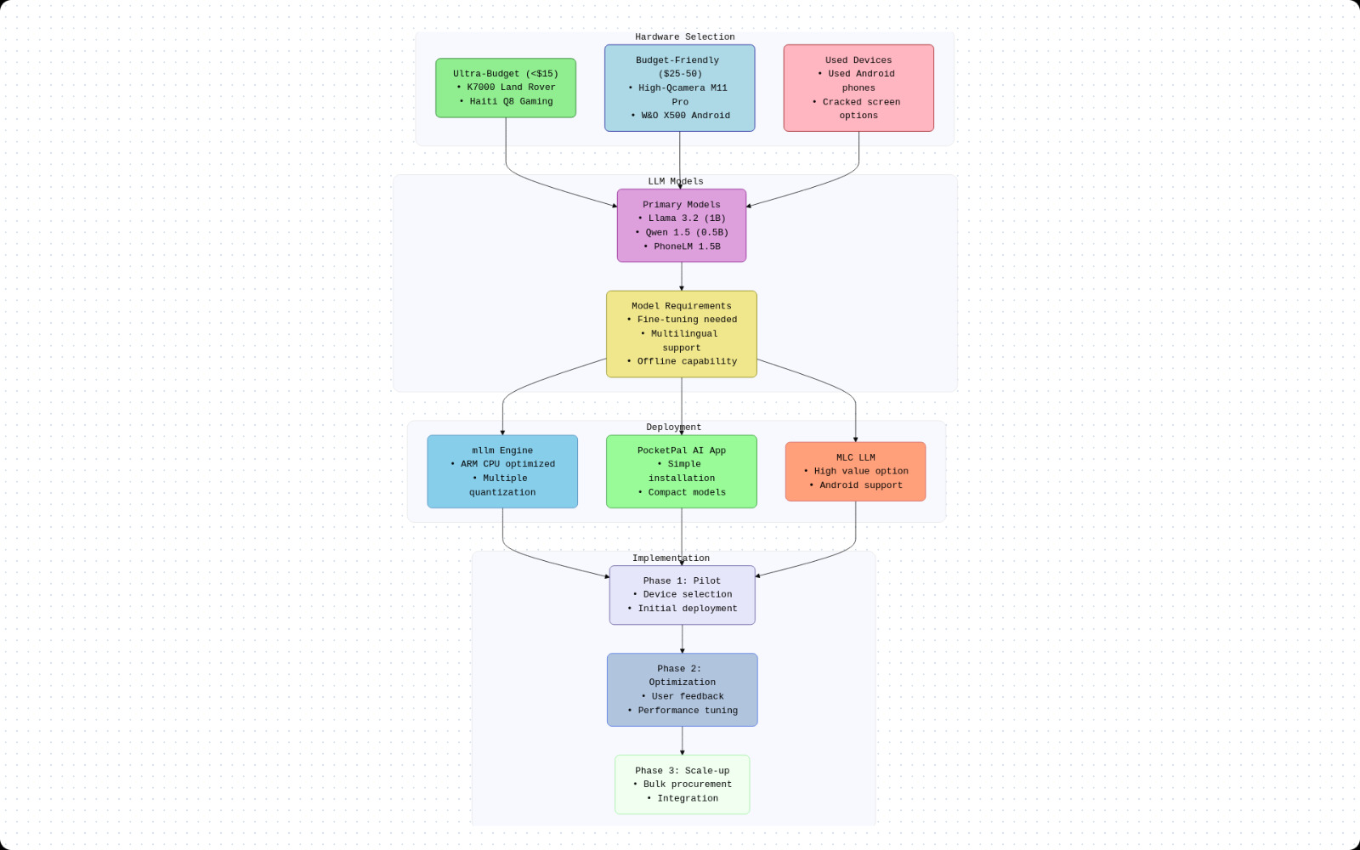
Notes:
IMPLEMENTATION

